Slide 1


House Price Prediction Model
Creator: Aye Thanda Htun

Slide 2
Contents
In this presentation, we are going to describe the following topic:
1. Objective
2. Data Preprocessing
2.1 Data Collection
2.2 Encoding Categorical Features
2.3 Data Splitting
3. Model Selection
4. Evaluation Model
5. Data Visualization
6. Model Performance Interpretation

Slide 3
1. Objective
The real estate market is a dynamic and complex ecosystem influenced by various factors such as location, economic conditions, and demographic trends. Traditional methods of predicting house prices often rely on historical data and expert analysis.
In this presentation, we will explore the process of creating a machine learning model for house price prediction in Bangkok. We will discuss the steps involved in data collection, preprocessing, feature engineering, model selection, and evaluation. By leveraging machine learning algorithms, we aim to develop a predictive model that can accurately estimate house prices based on various input variables.
Our goal is to empower stakeholders in the real estate industry with a powerful tool that can assist in decision-making.

Slide 4
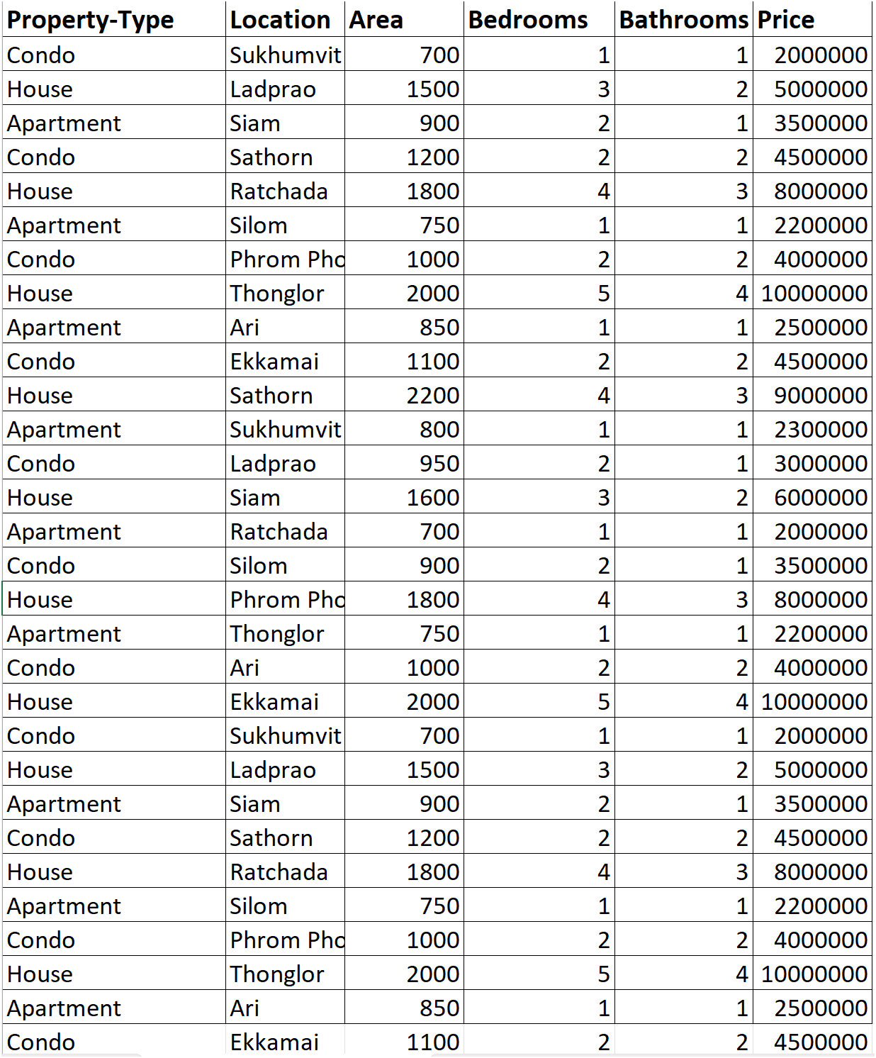
2. Data Preprocessing
2.1 Data Collection
In the data collection stage, we gathered 563 records of historical data from Bangkok’s sources, comprising four key features: Property-Type, Location, Area, Bedrooms, Bathrooms and Price. These features were selected based on their relevance and significance in influencing house prices.

Slide 5
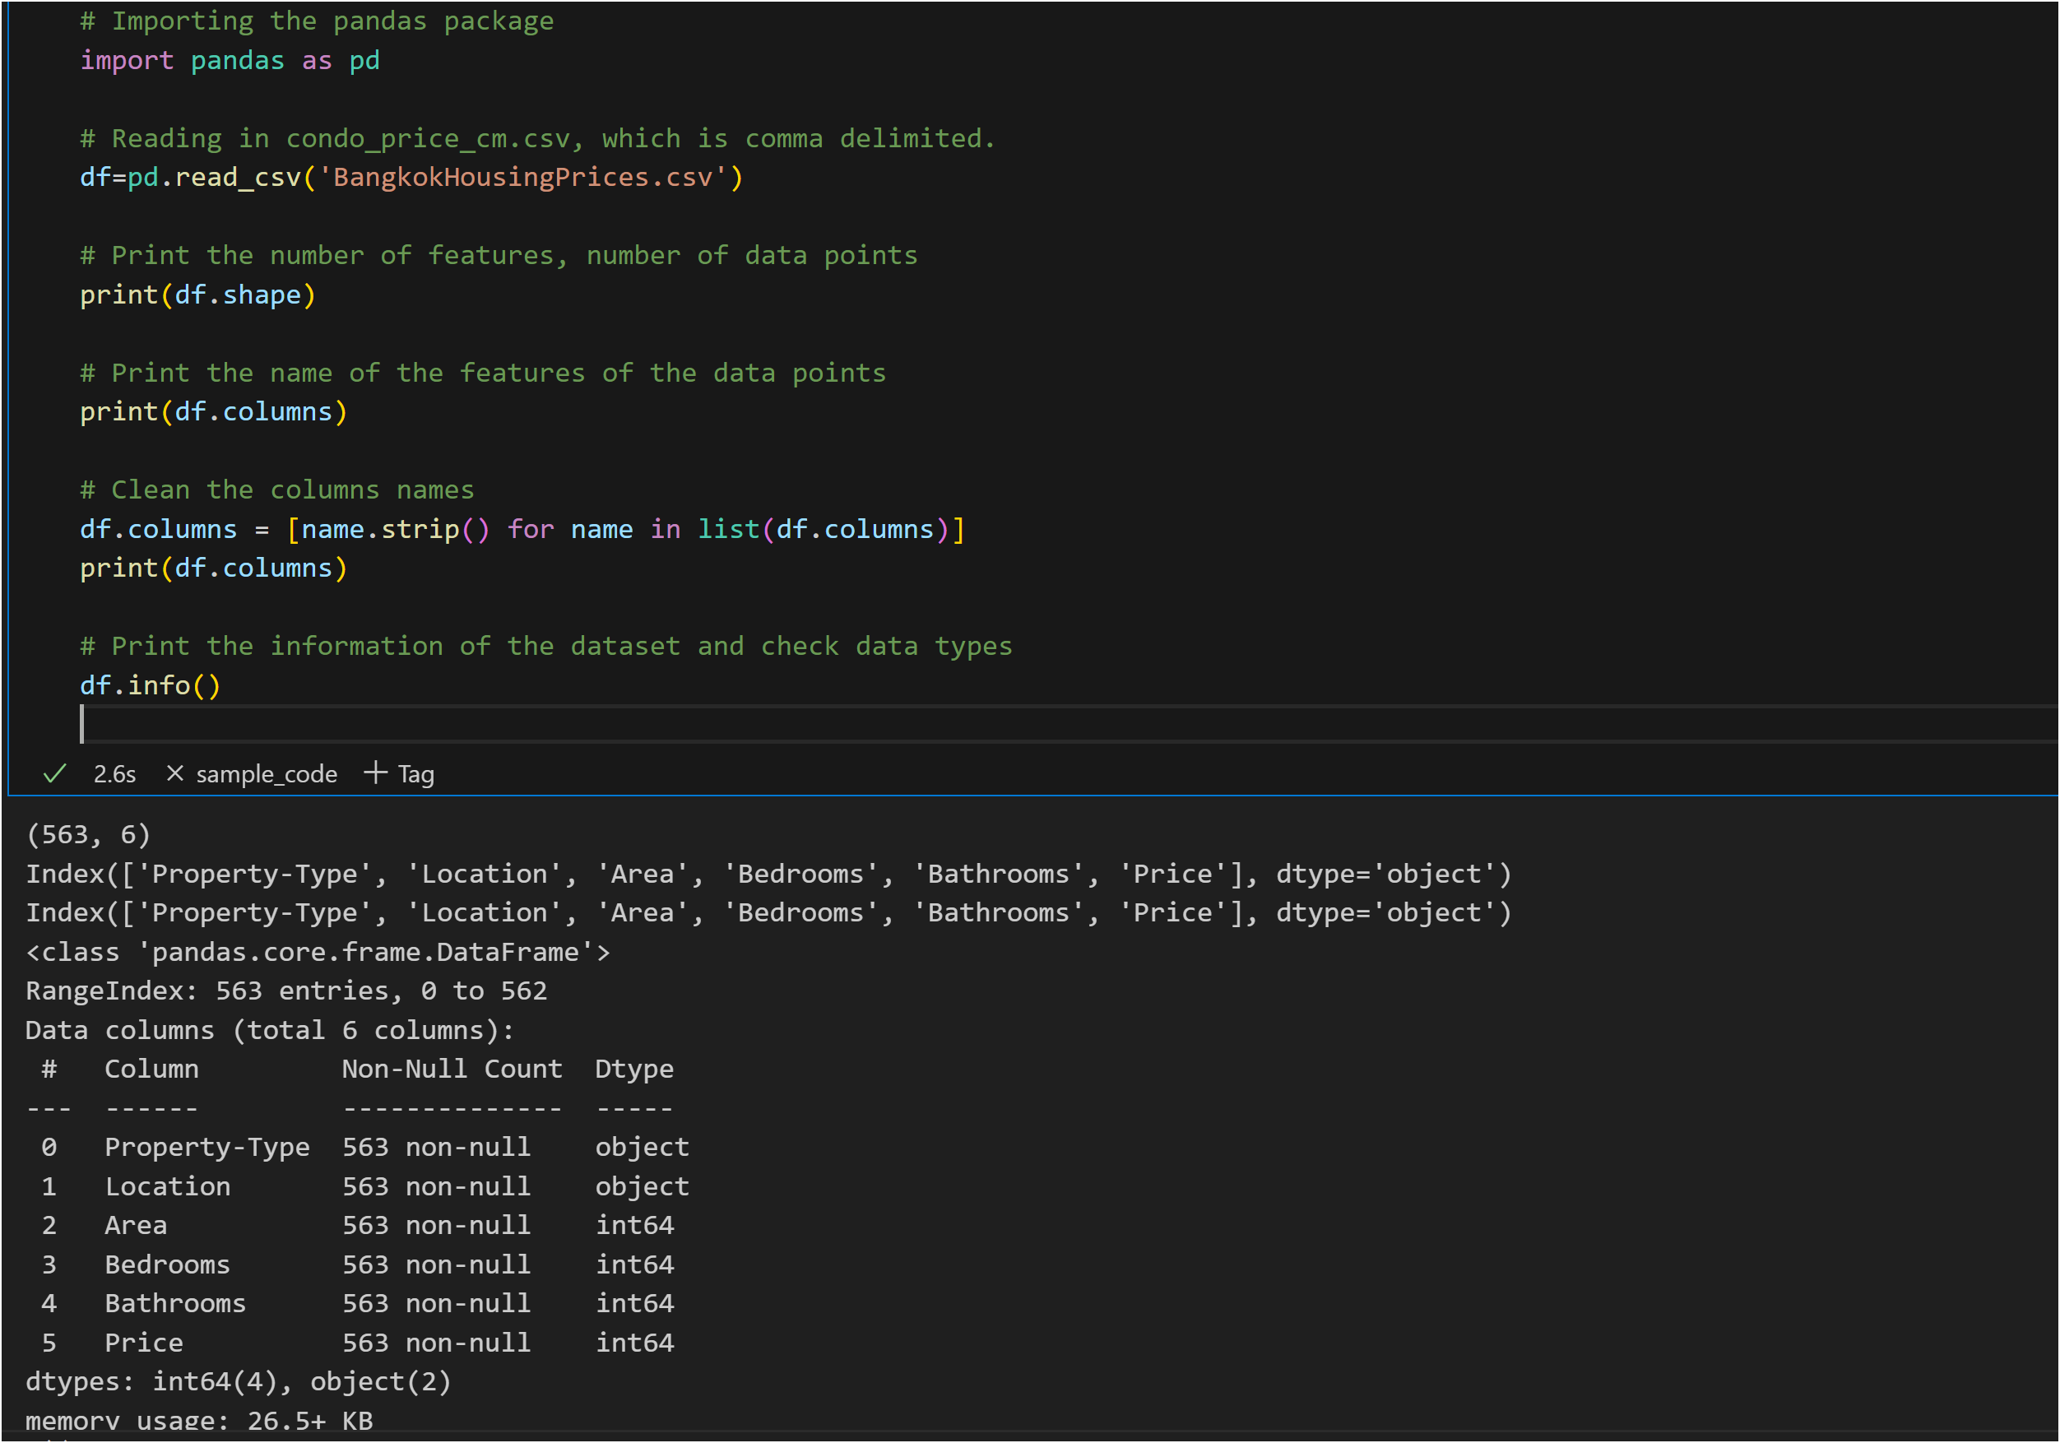
To verify the data cleaning, the coding result is shown as the well-prepared data list below.

Slide 6
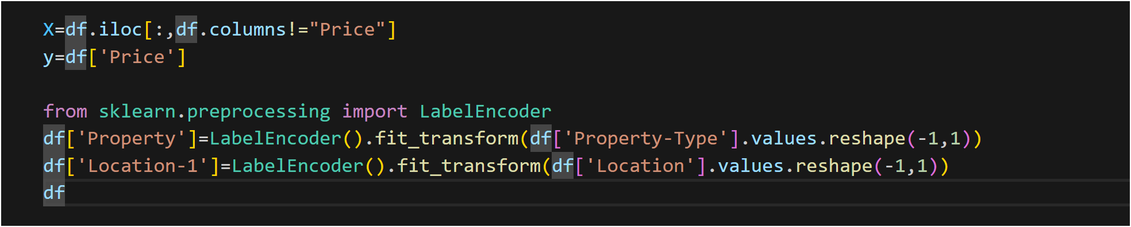
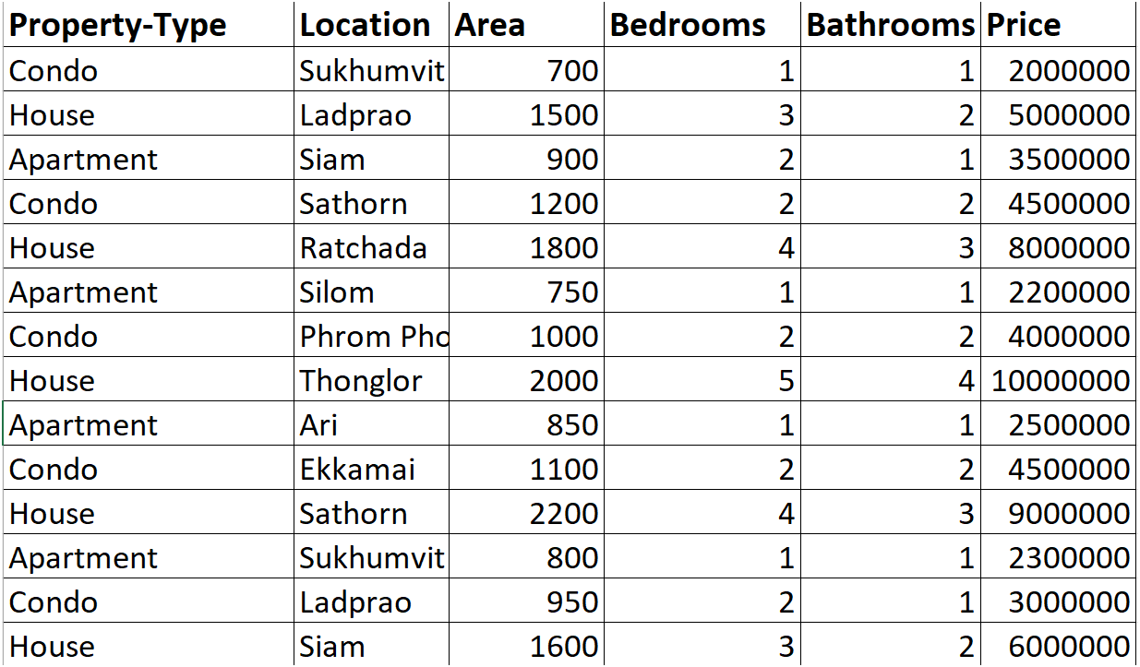
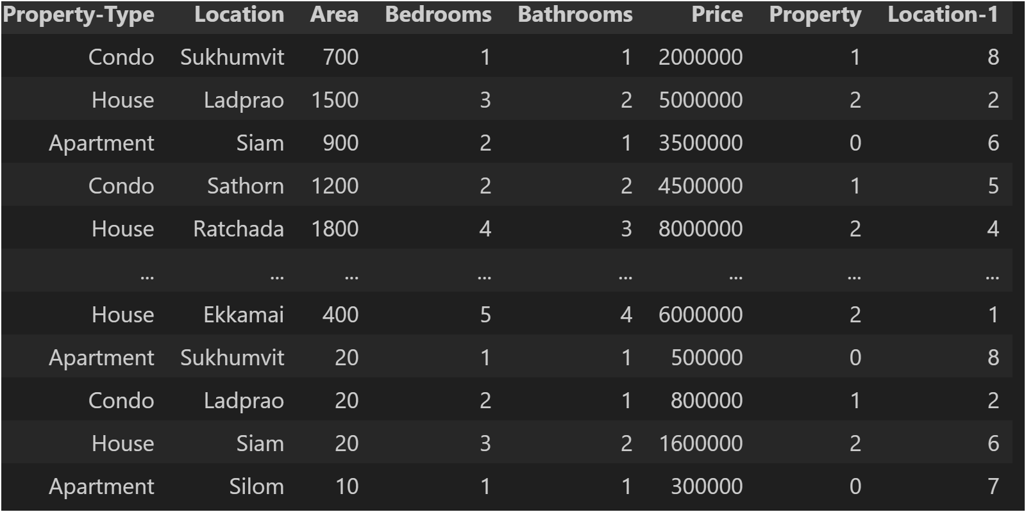
2.2 Encoding Categorical Features
There are two categorical features: Property-Type and Location.
We used the encoder function from the sklearn library to encode these two columns as shown below.
Before encoding After encoding

Slide 7
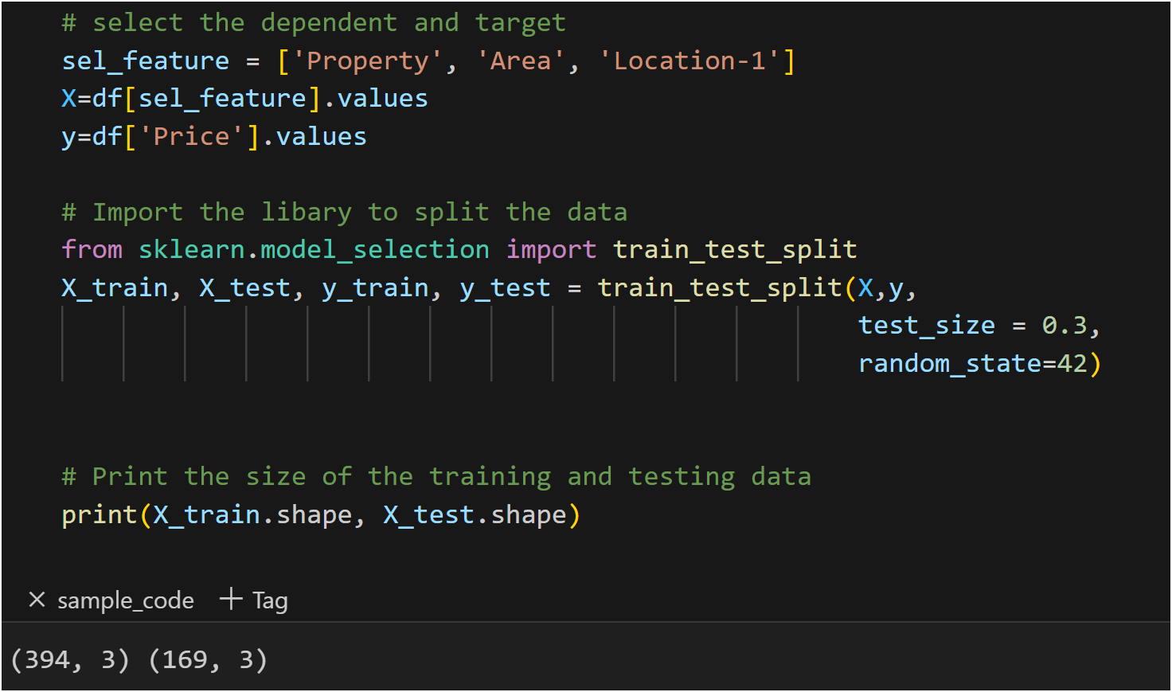
2.3 Data Splitting Data splitting, also known as data partitioning, is a crucial step in machine learning model development. It involves dividing a dataset into multiple subsets for different purposes, typically training and testing/validation. The following code demonstrates two things. First, we will predict house prices in Bangkok using three features: Property, Area, and Location-1. Second, it shows how we split the data into training and testing sets. 30% of the data will be used for testing purposes, while 70% will be used for training.

Slide 8
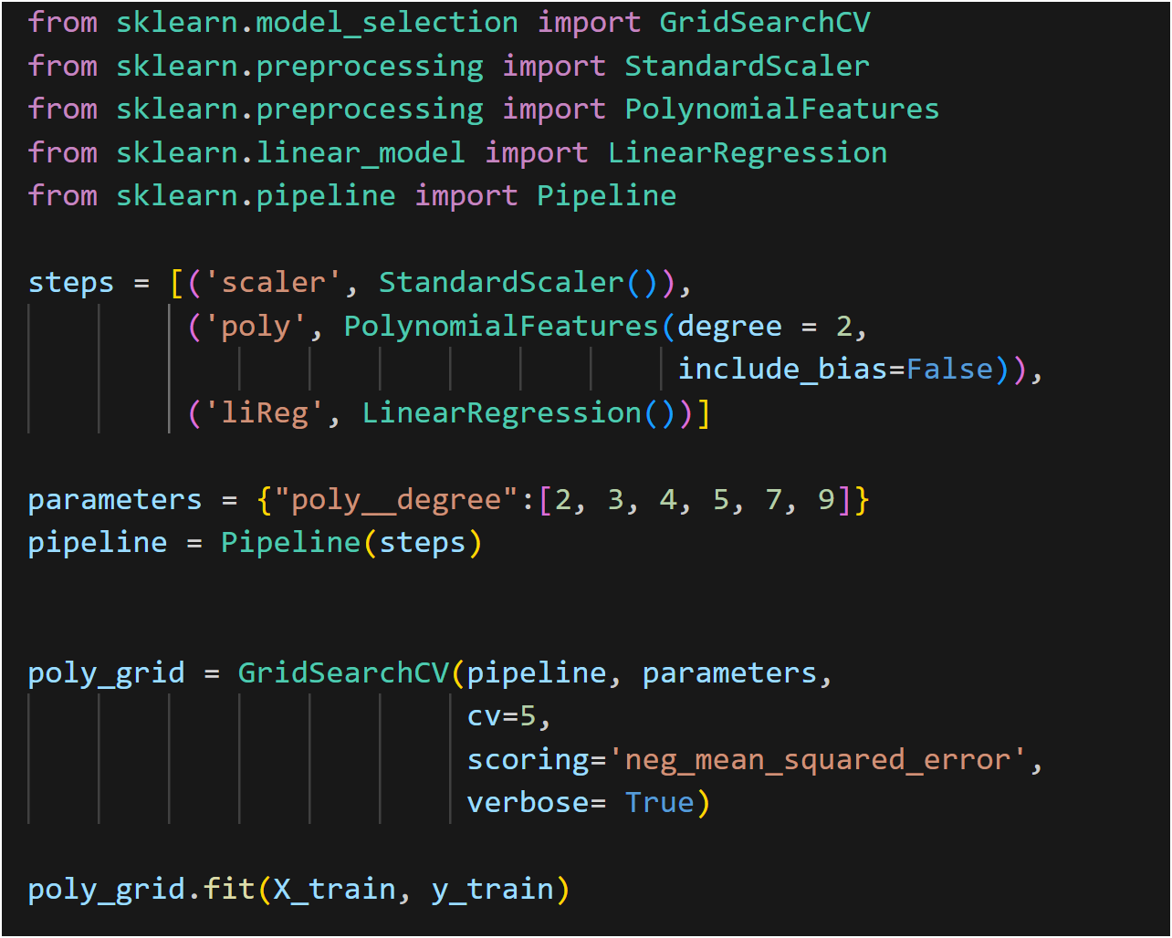
3. Model Selection To accurately predict house prices, choosing the right model is crucial. We explored various models and ultimately selected polynomial regression due to its ability to capture the non-linear relationships between features and the target variable. Why Polynomial Regression? Polynomial regression is an extension of linear regression, which allows for a more flexible fit to the data by including polynomial terms. This flexibility can be particularly beneficial when the relationship between the independent variables and the dependent variable is not strictly linear.

Slide 9
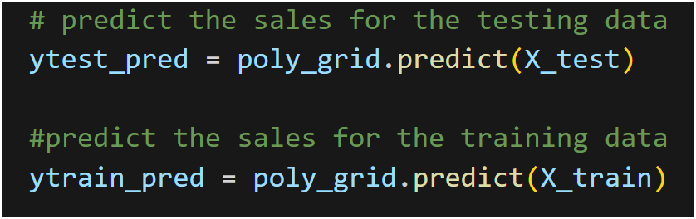
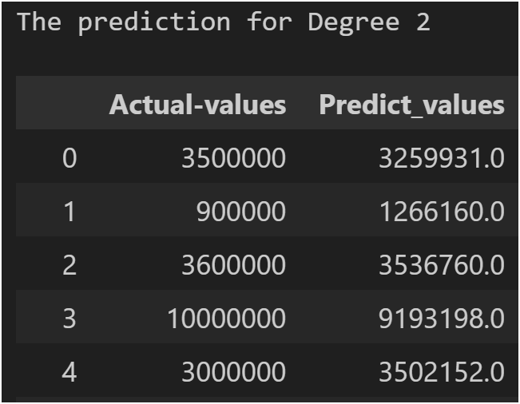
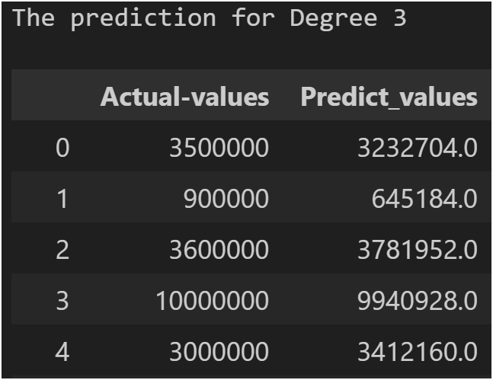
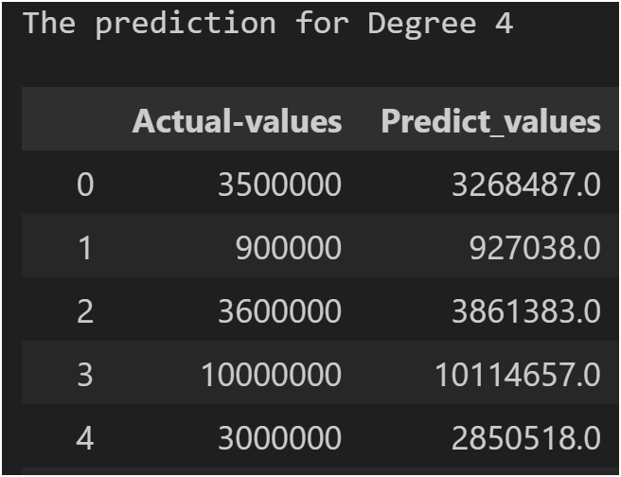
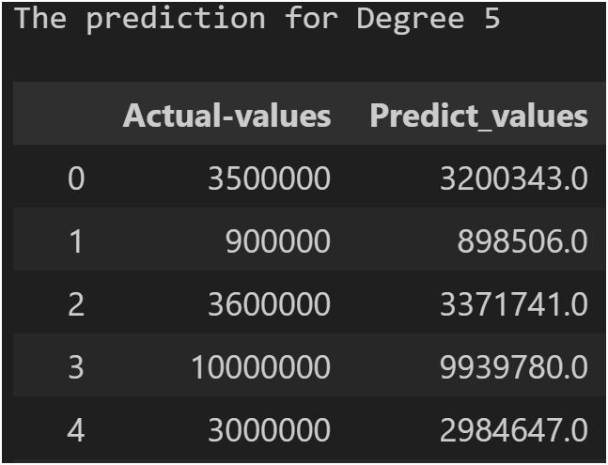
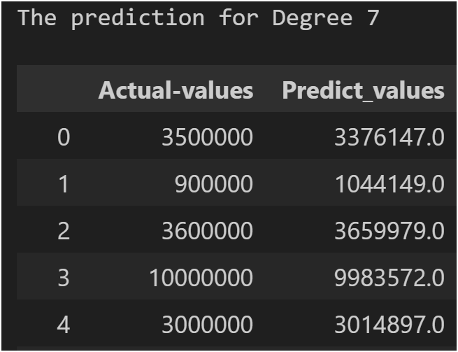
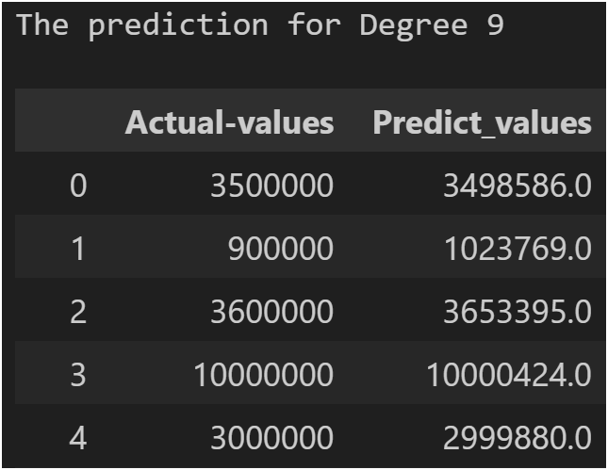
4. Evalution model To determine the optimal complexity of our polynomial regression model, we experimented with different degrees of the polynomial. The following results are shown for different degrees (2,3,4,5,7,9) by using polynomial prediction method.

Slide 10
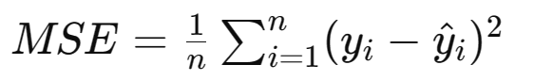
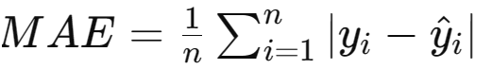
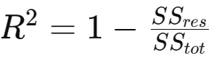
Evaluation Matrics There are three metrics, Mean Square Error (MSE), Mean Absolute Error (MAE), and R^2 score, serve different purposes in evaluating the performance of regression models:
1. Mean Square Error (MSE)
Mean Square Error is a metric used to measure the average squared difference between the actual and predicted values in a regression problem. It is calculated by taking the average of the squares of the differences between the predicted values and the actual values. Mathematically, MSE is represented as:
2. Mean Absolute Error (MAE)
Mean Absolute Error is a metric used to measure the average absolute difference between the actual and predicted values in a regression problem. It is calculated by taking the average of the absolute differences between the predicted values and the actual values. Mathematically, MAE is represented as:
3. R^2 Score (Coefficient of Determination):
The R^2 score, also known as the coefficient of determination, is a statistical measure that represents the proportion of the variance in the dependent variable that is predictable from the independent variables. It ranges from 0 to 1 and indicates the goodness of fit of the model. A score closer to 1 indicates a better fit, while a score closer to 0 indicates a poor fit. Mathematically, R^2 score is represented as:
where 𝑆𝑆𝑟𝑒𝑠SSres is the sum of squares of residuals (the difference between the actual values and the predicted values), and 𝑆𝑆𝑡𝑜𝑡SStot is the total sum of squares (the difference between the actual values and the mean of the actual values).

Slide 11
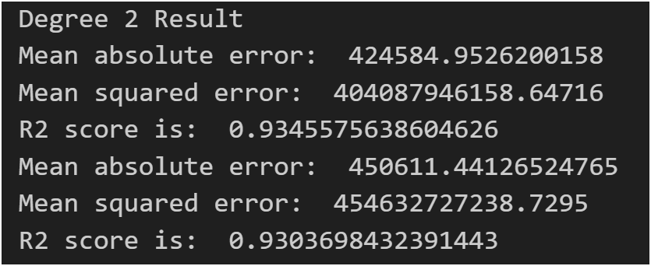
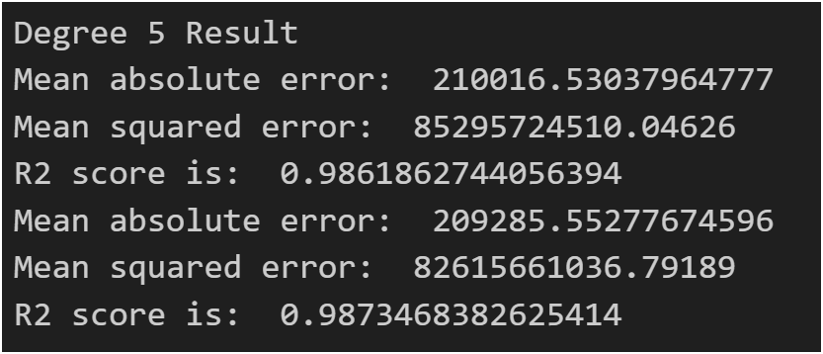
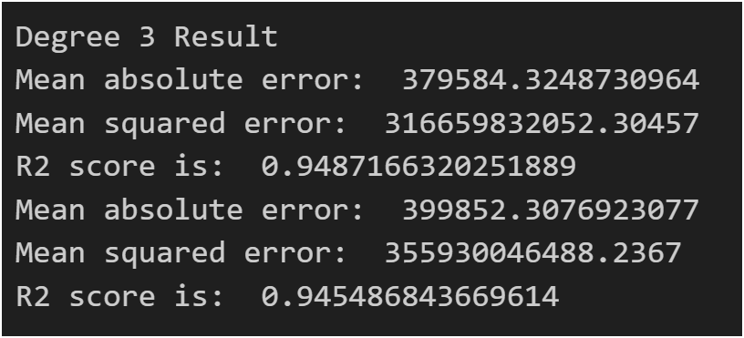
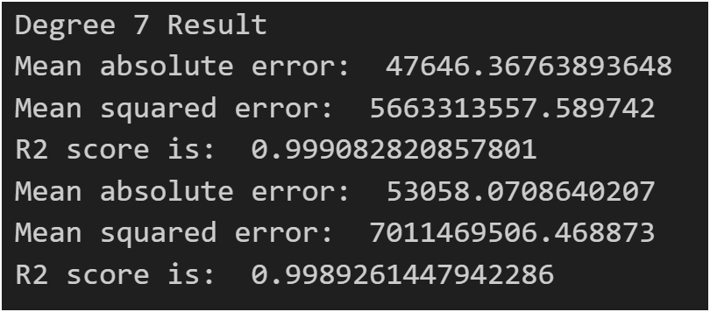
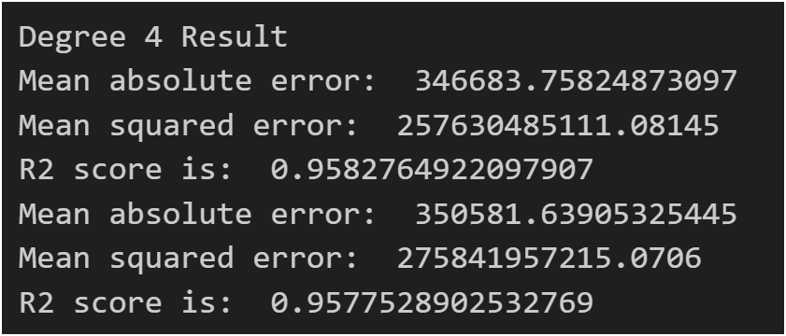
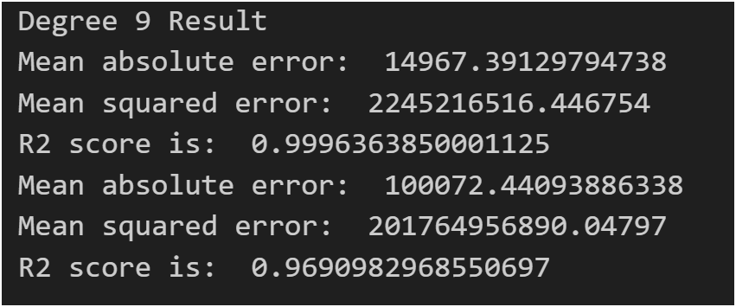
Evaluation the model by using three matrices By examining the reviews, all degrees are considered to be highly fitting. However, we have opted for degree 7 as the most suitable, based on the R² score between the actual and testing data.

Slide 12
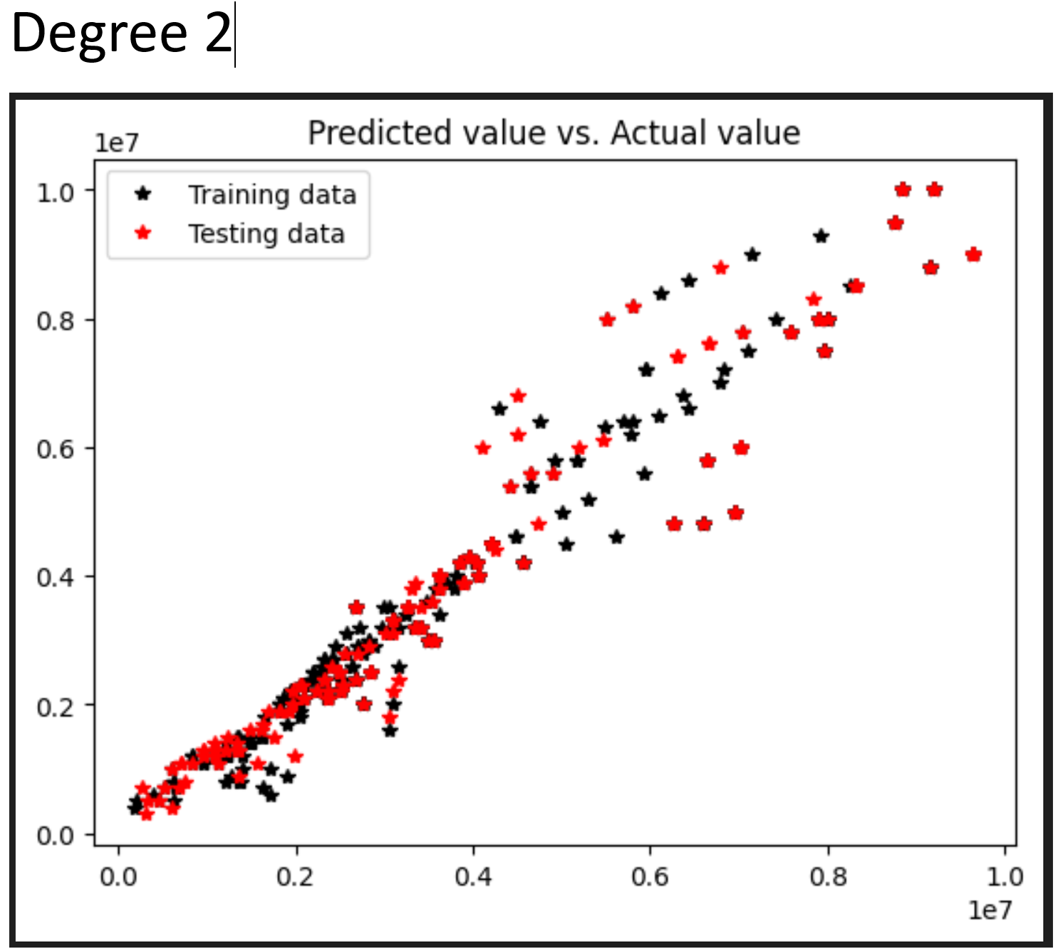
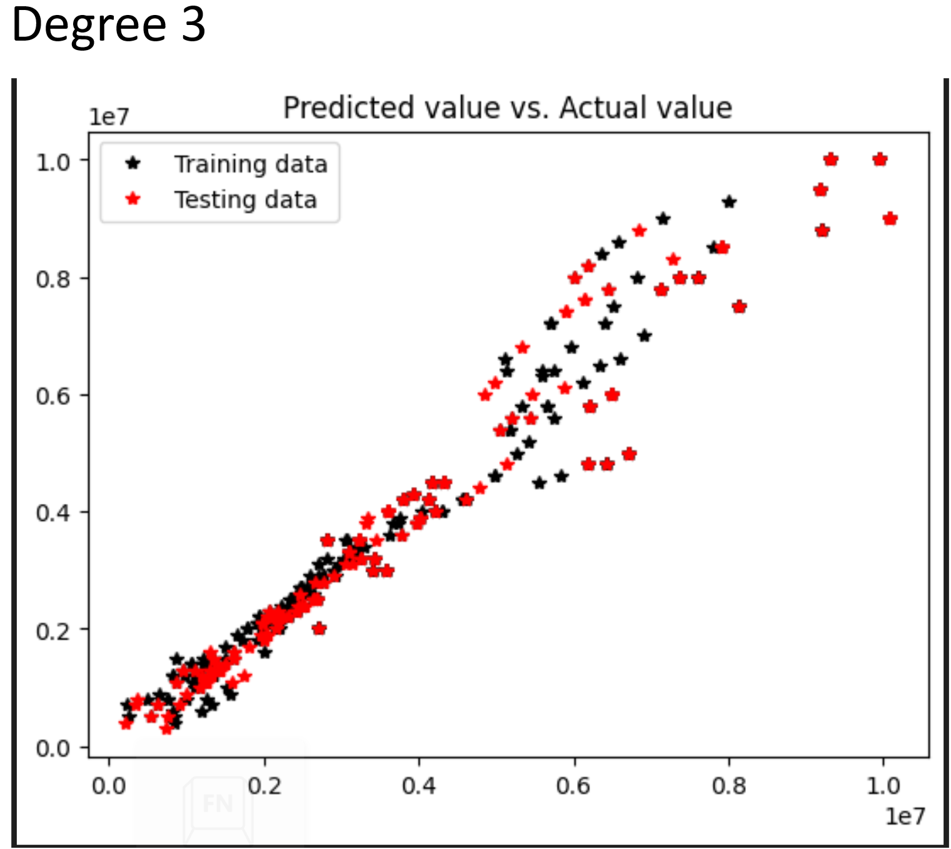
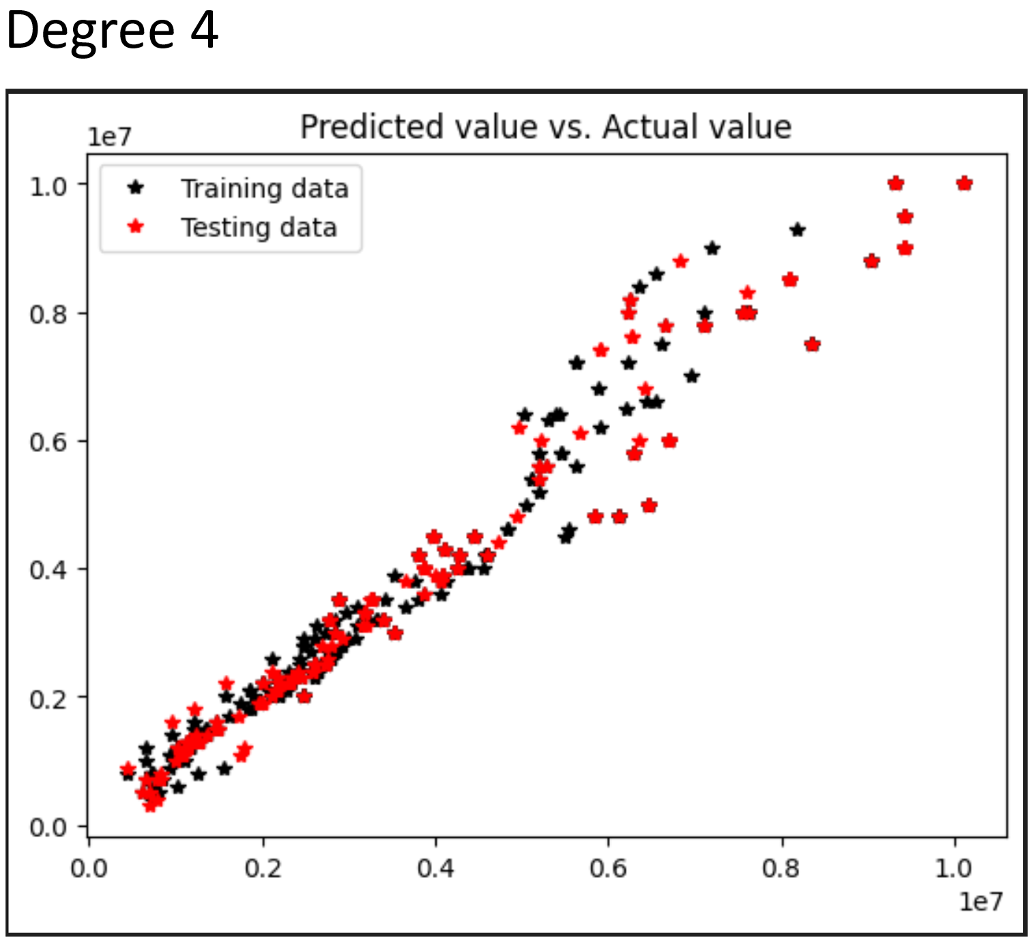
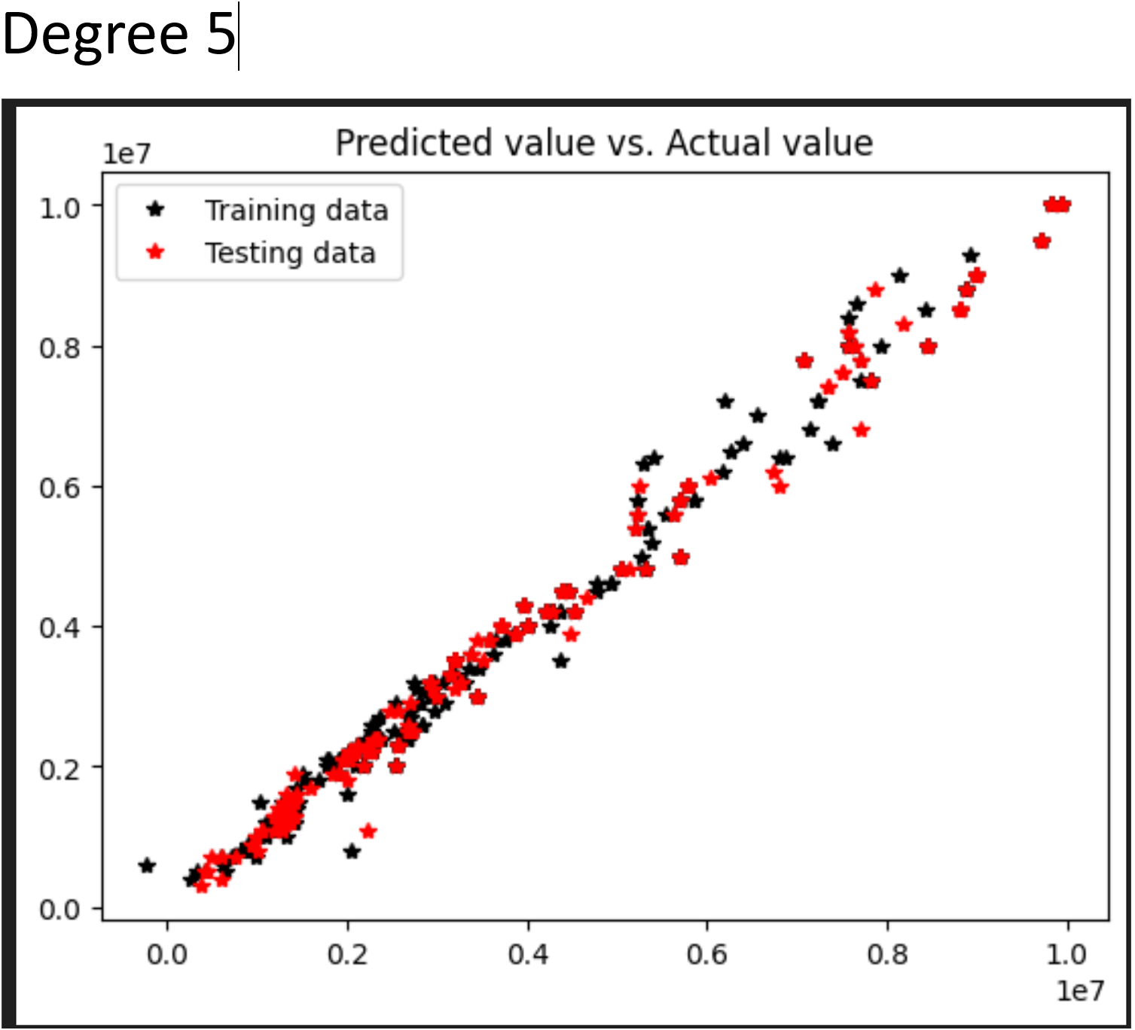
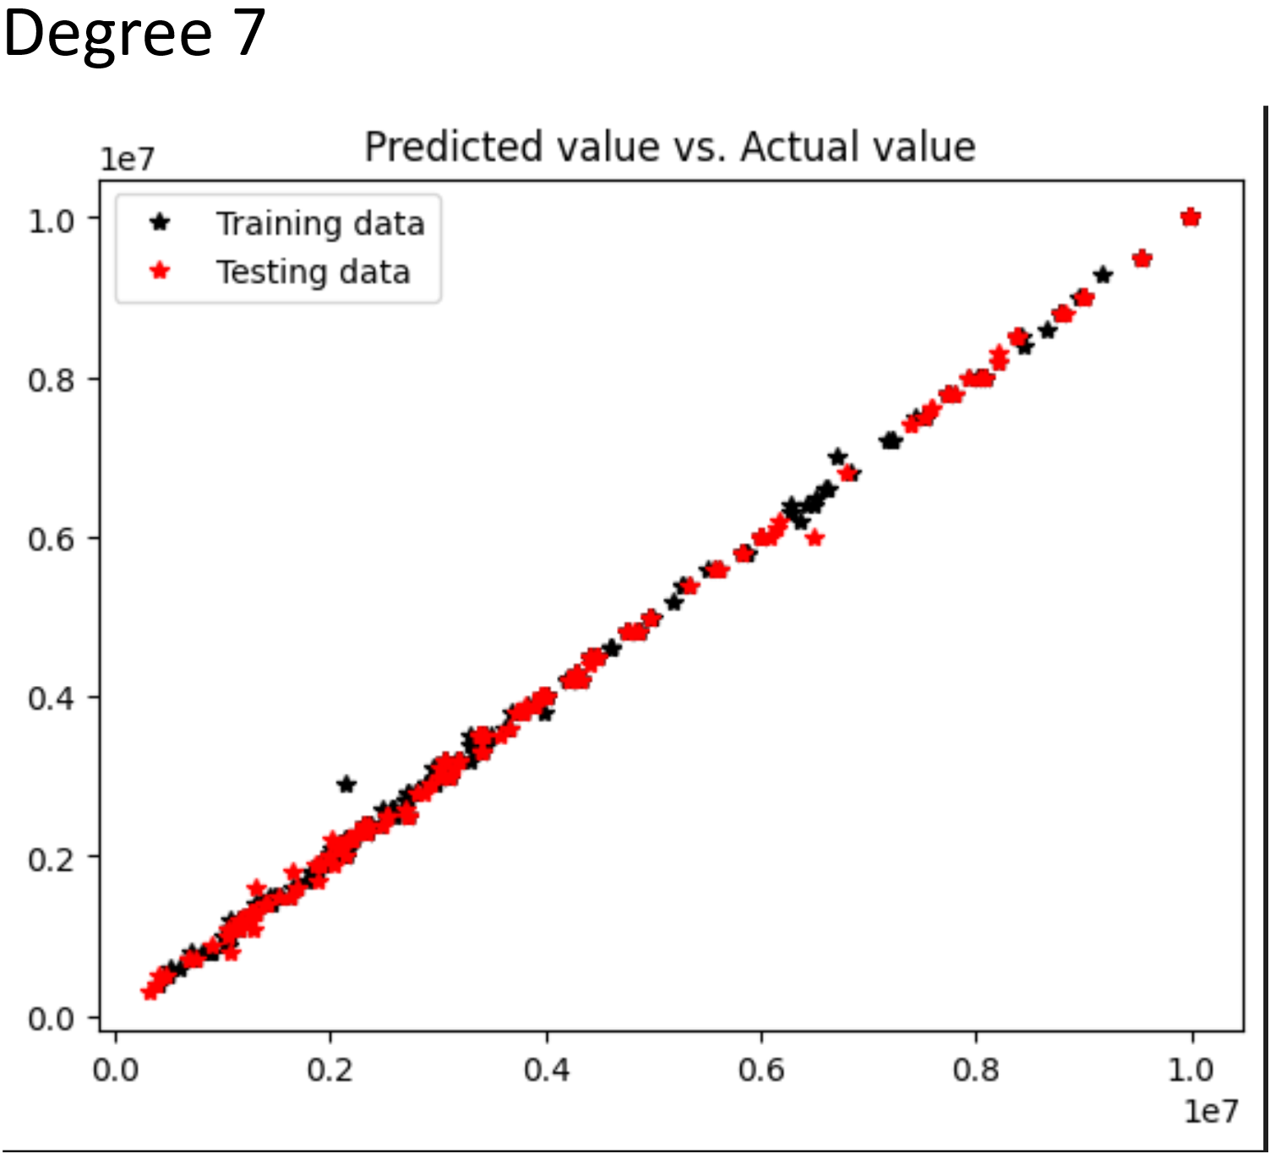
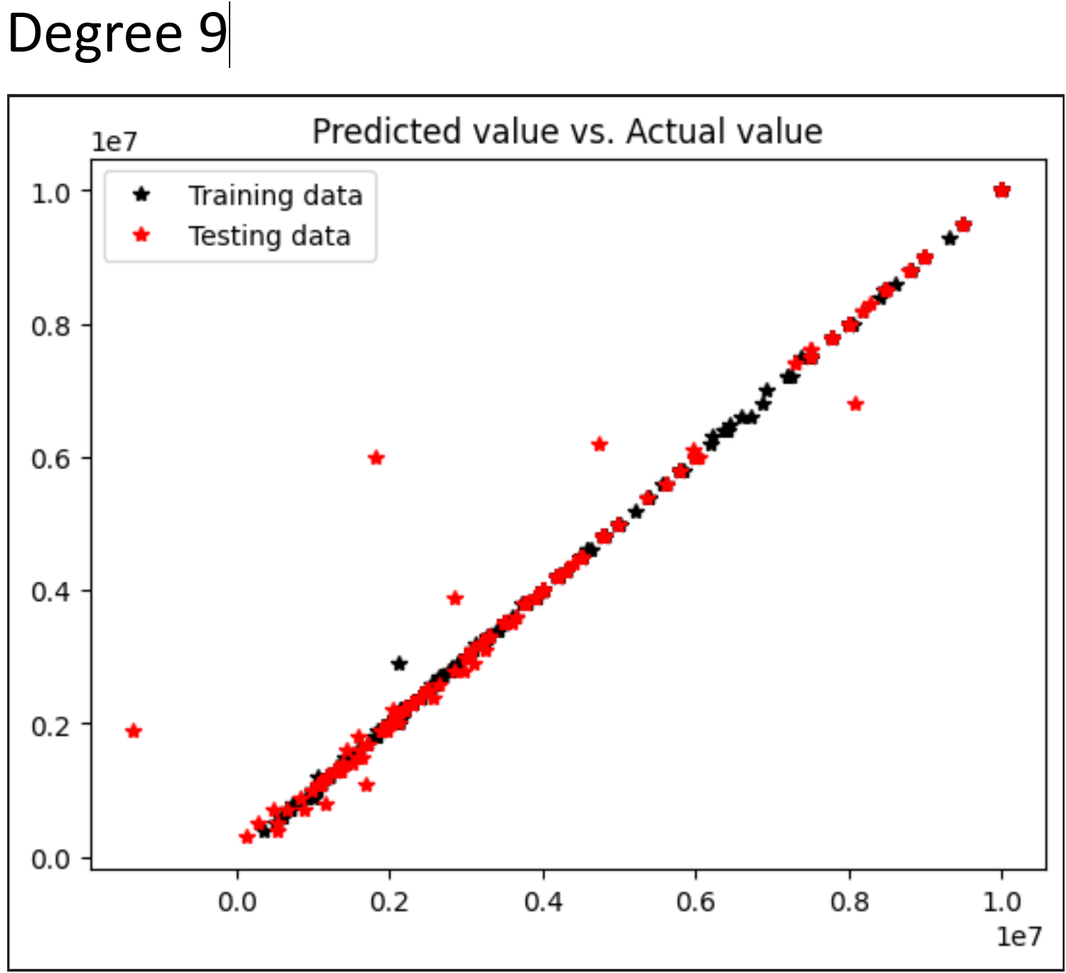
5. Data Visualization When visualizing the data in charts, it's evident that the seventh-degree polynomial fits well between the actual and predicted values.

Slide 13
5. Model Performance Interpretation
By examining the variance between actual values and predicted values using polynomial regression and evaluating three metrics, it becomes evident that degree 7 yields the most superior fit.
The differences in variance between actual values and predicted values are minimal and very consistent. Additionally, in the pivot chart, the red and blue plots are almost perfectly overlapped. These observations led us to conclude that degree 7 is the optimal choice for achieving a superb fit.

Slide 14
Thank you.

